Slide 1
HUMAN COMPUTER INTERACTION (314445)
Prof.Pankaj A. Dhakate
Information Technology
Sinhgad Institute of Technology, Lonavala
Email:pad.sit@sinhgad.edu
Contact No.+91-7588501261

Slide 2
Objectives and Outcomes
Unit Objectives: On completion the students will be able to:
Gain an understanding of the human part of human-computer-interactions.
To understand HCI design processes
To learn to do design and evaluate effective human-computer-interactions
Unit Outcomes:
Able to define and measure the information
To explain importance of HCI study and principles of user-centred design (UCD) approach.
To develop understanding of human factors in HCI design.
To apply cognitive models for predicting human-computer-interactions.
Outcome Mapping: PEO: I,V , PEO c, e CO: 1, 2,3,4,5 PSO: 3,4
Reference Books Used
T1: Alan Dix (2008). Human Computer Interaction. Pearson Education. ISBN 978-81-317-1703-5.

Slide 3
UNIT 6: HCI -FUTURE TRENDS
What is ubiquitous computing technology? Our general working definition is any computing technology that permits human interaction away from a single workstation. This includes pen-based technology, handheld or portable devices, large-scale interactive screens, wireless networking infrastructure, and voice or vision technology.
Realizing the human-centered vision of ubicomp with these technologies presents many challenges.
Here we will focus on three:
Defining the appropriate physical interaction experience;
Discovering and Innovating general application features;
Theories for designing and evaluating the human experience within ubicomp.

Slide 4
ubiquitous computing
The traditional computer is a glass box – all you can do is press buttons and see the effect.
Ubiquitous computing and augmented reality systems break this glass box by linking the real world with the electronic worlds.
Ubiquitous computing is a concept in software engineering, hardware engineering and computer science where computing is made to appear anytime and everywhere. In contrast to desktop computing, ubiquitous computing can occur using any device, in any location, and in any format.
Applications include:
– ubiquitous computing
– virtual reality
– augmented reality
– information visualization.

Slide 5
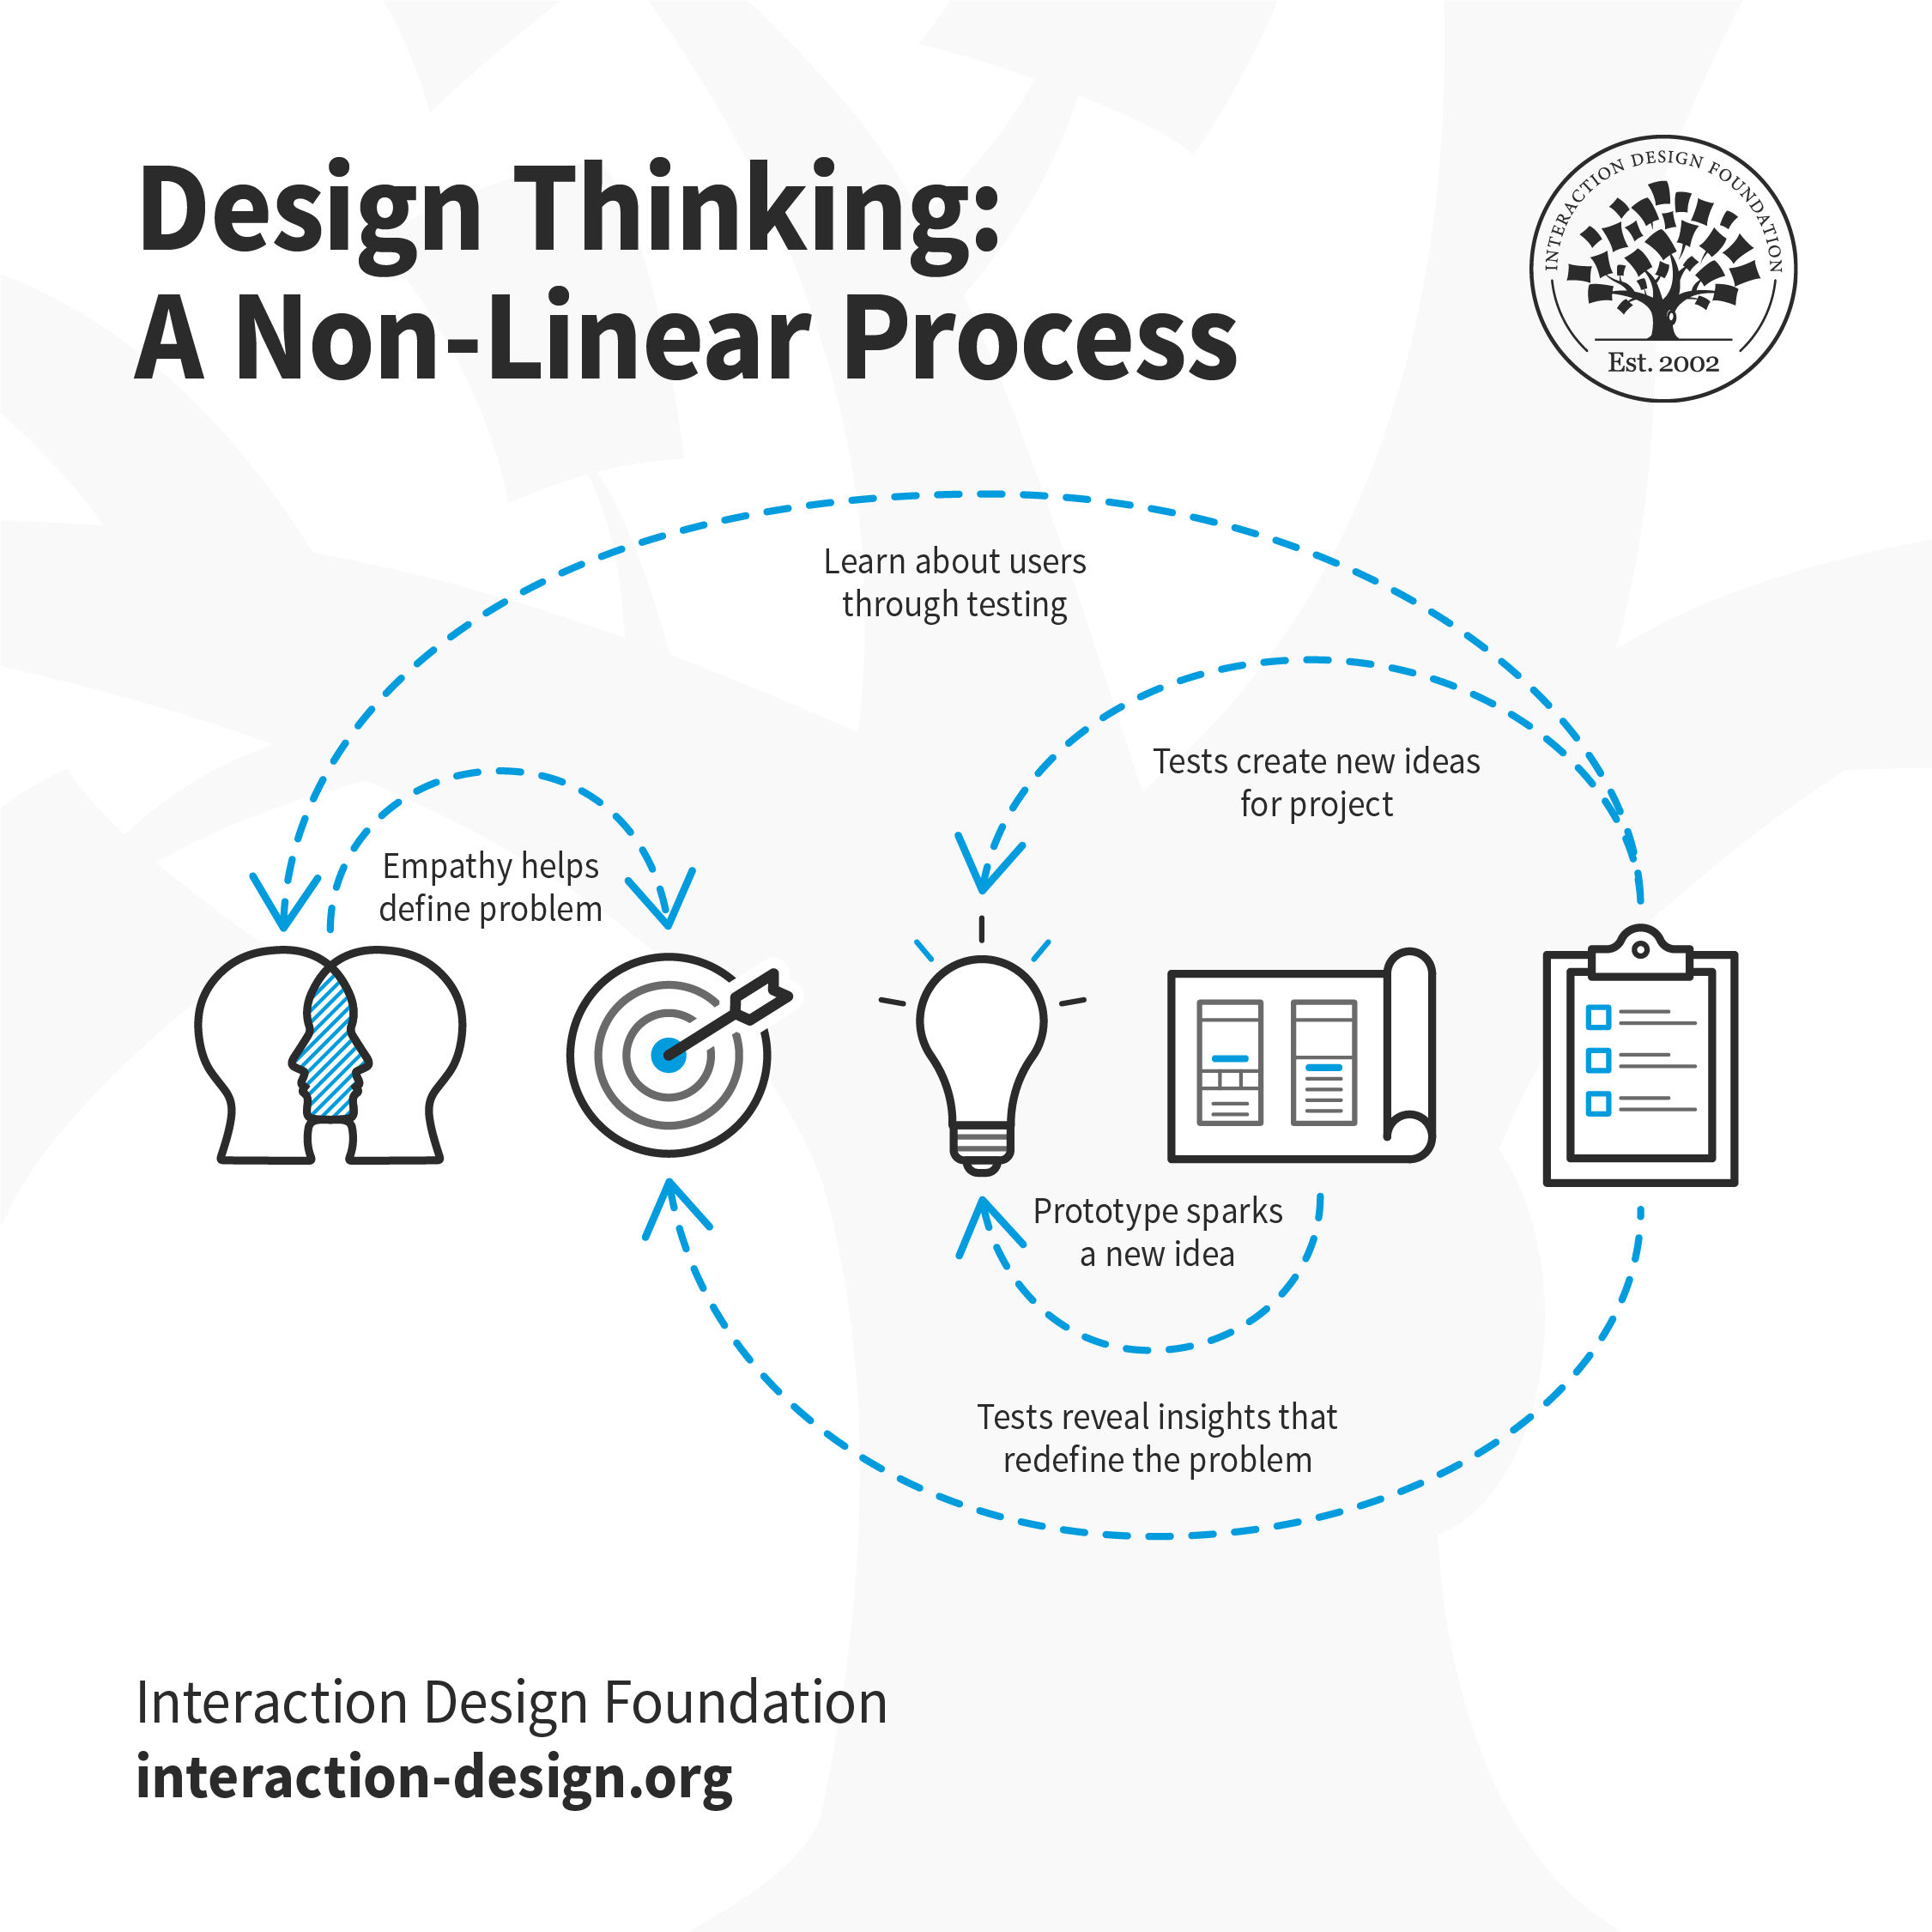
Design thinking
Design thinking is an iterative, non-linear process which focuses on a collaboration between designers and users. It brings innovative solutions to life based on how real users think, feel and behave. This human-centered design process consists of five core stages Empathize, Define, Ideate, Prototype and Test.

Slide 6
Design thinking
What are the 5 Stages of the Design Thinking Process
The five stages of design thinking, according to the d.school, are:
Empathize: research your users' needs.
Define: state your users' needs and problems.
Ideate: challenge assumptions and create ideas.
Prototype: start to create solutions.
Test: try your solutions out.

Slide 7
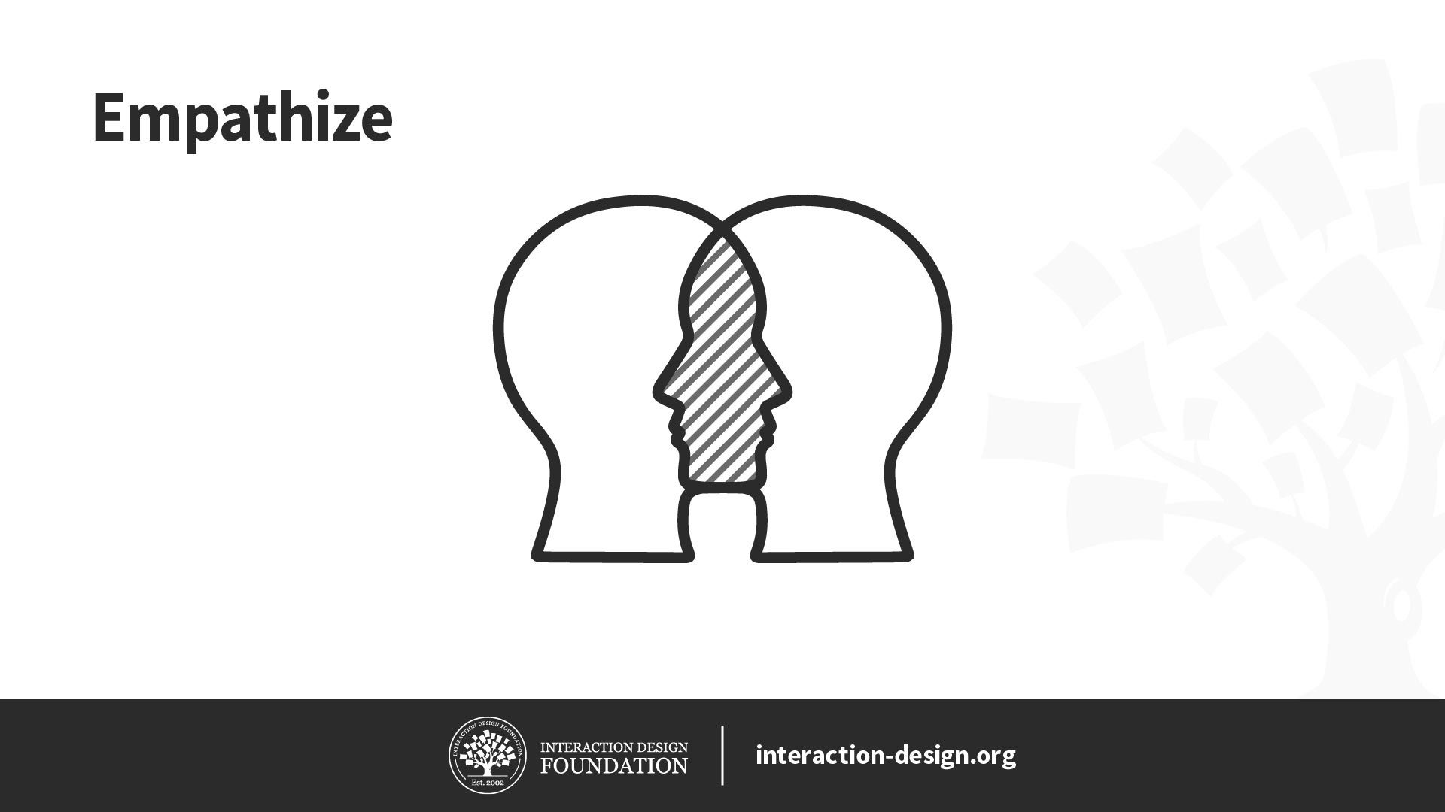
Design thinking
Stage 1: Empathize—Research Your Users' Needs
Empathize: the first Empathize: the first phase of design thinking, where you gain real insight into users and their needs.
Empathy is crucial to problem solving and a human-centered design process as it allows design thinkers to set aside their own assumptions about the world and gain real insight into users and their needs.

Slide 8
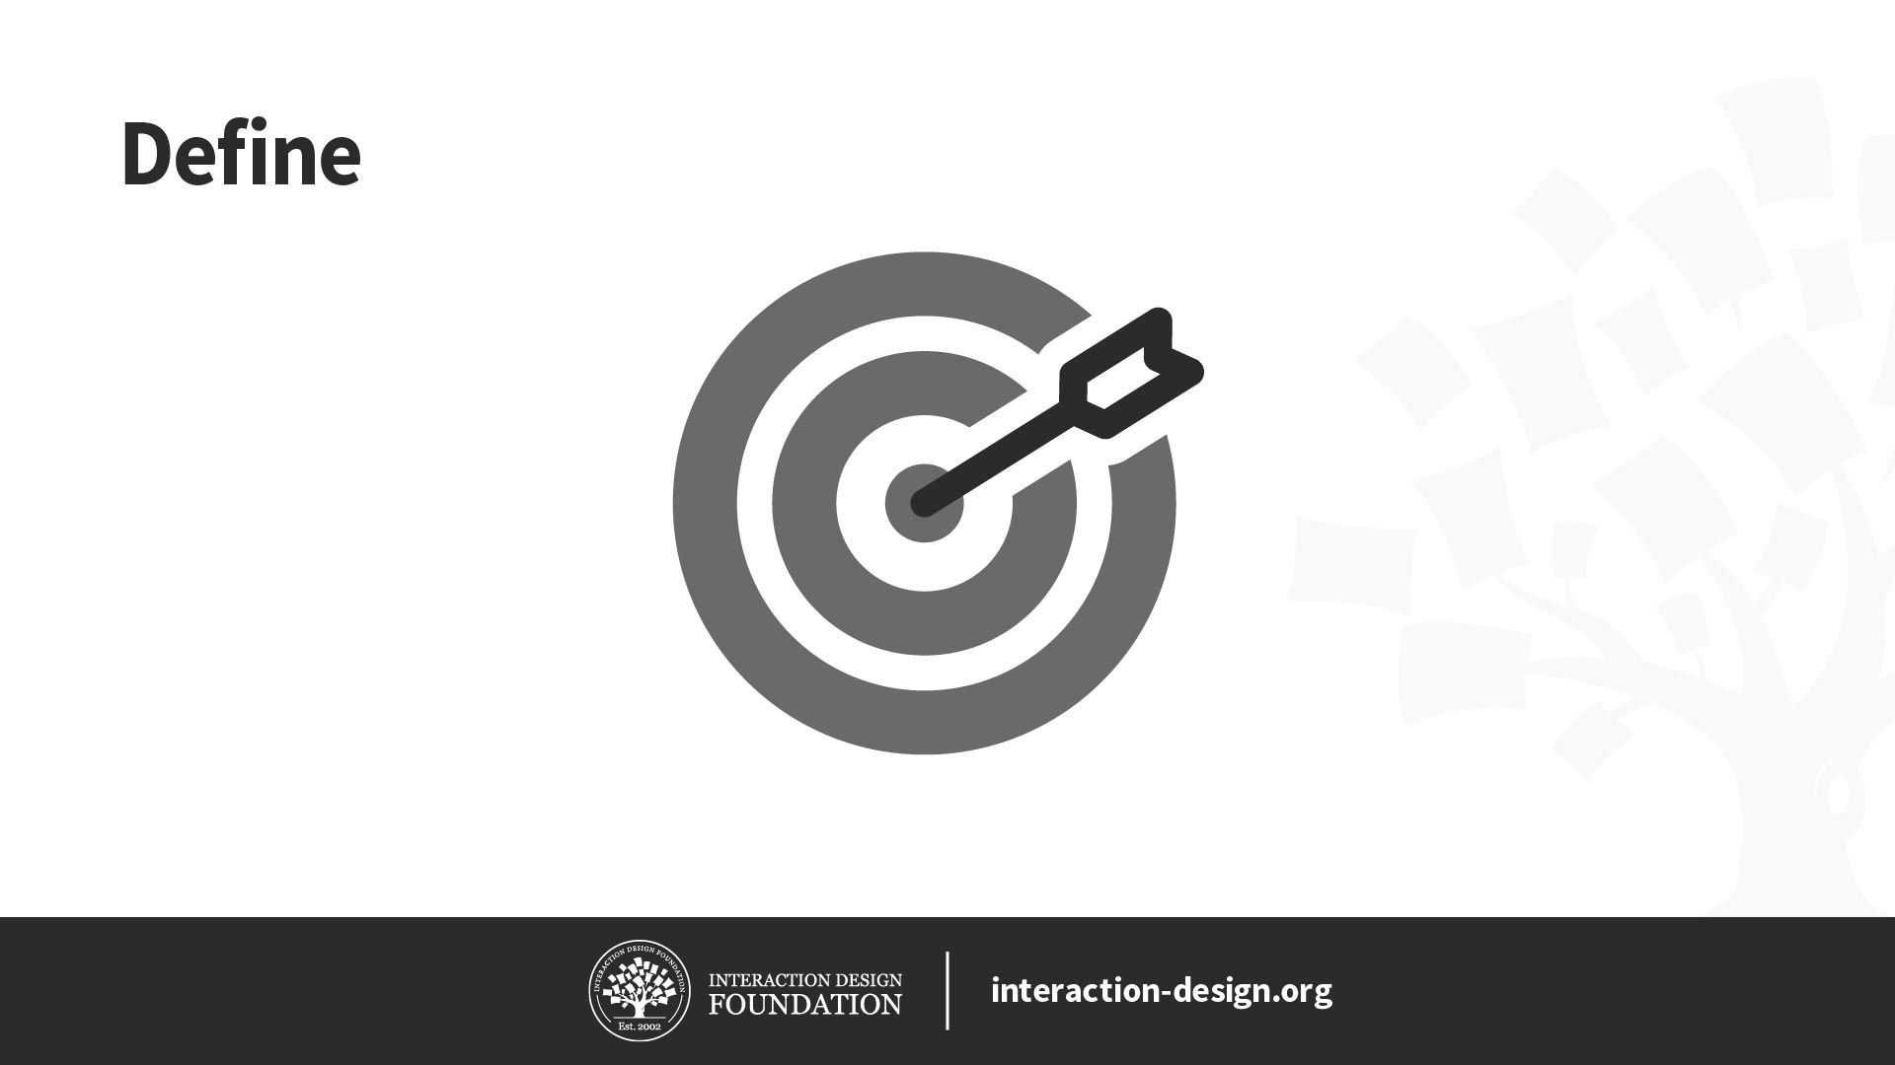
Design thinking
Stage 2: Define—State Your Users' Needs and Problems
Define: the second phase of design thinking, where you define the problem statement in a human-centered manner.
Defining the problem and problem statement must be done in a human-centered manner.
For example, you should not define the problem as your own wish or need of the company: “We need to increase our food-product market share among young teenage girls by 5%.”
You should pitch the problem statement from your perception of the users’ needs: “Teenage girls need to eat nutritious food in order to thrive, be healthy and grow.”

Slide 9
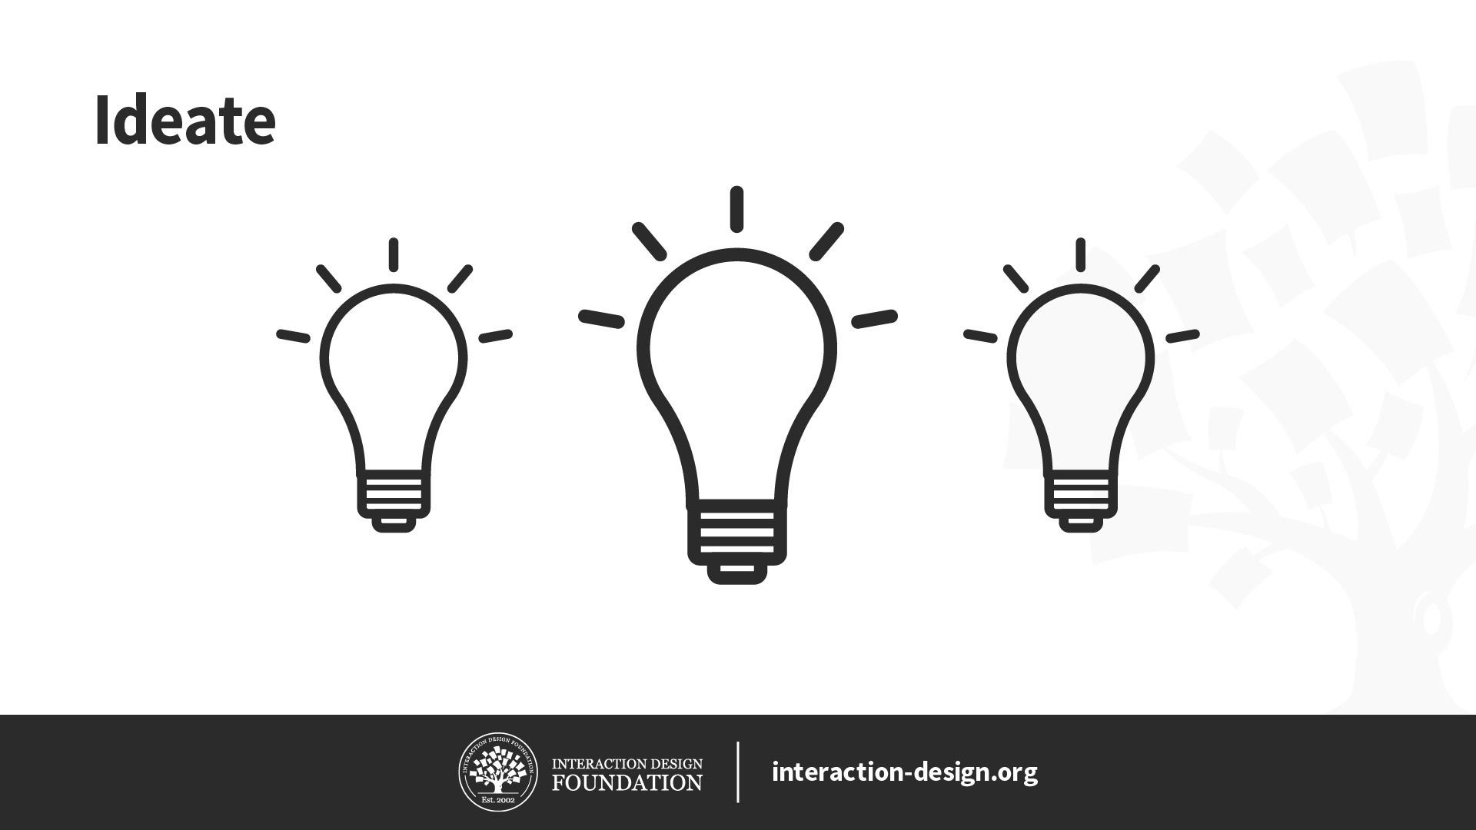
Design thinking
Stage 3: Ideate—Challenge Assumptions and Create Ideas
Ideate: the third phase of design thinking, where you identify innovative solutions to the problem statement you’ve created.
look at the problem from different perspectives and ideate innovative solutions to your problem statement.

Slide 10
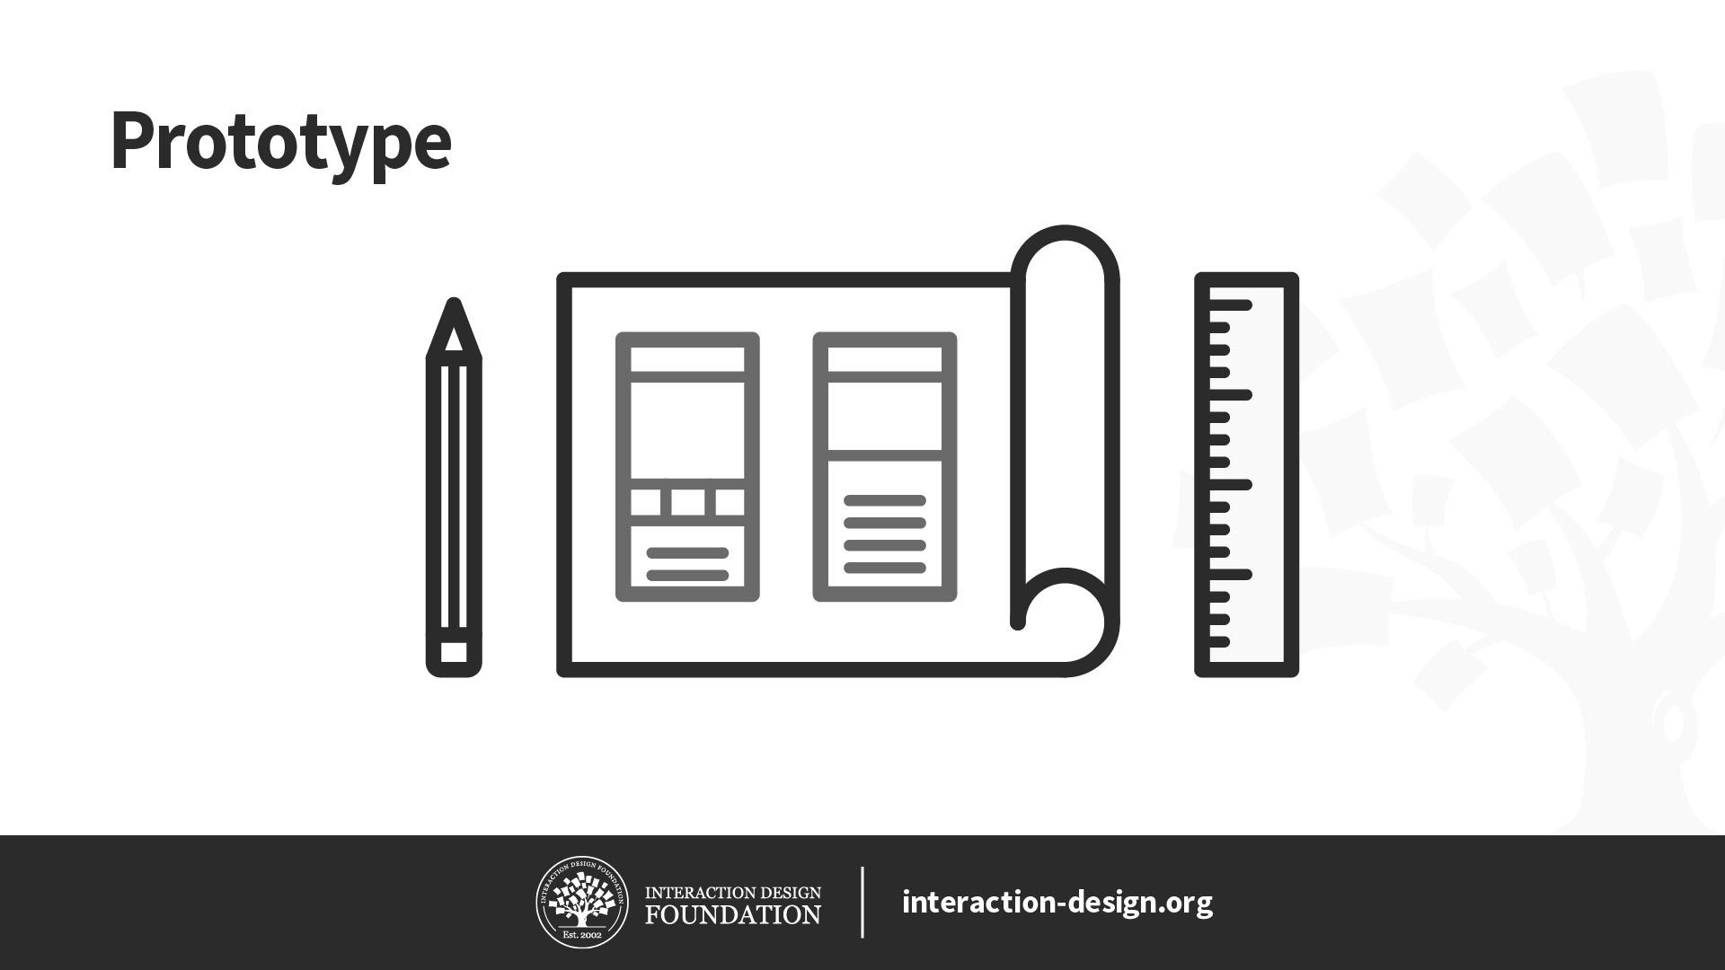
Design thinking
Stage 4: Prototype—Start to Create Solutions
Prototype: the fourth phase of design thinking, where you identify the best possible solution.
The design team will now produce a number of inexpensive, scaled down versions of the product (or specific features found within the product) to investigate the key solutions generated in the ideation phase. These prototypes can be shared and tested within the team itself, in other departments or on a small group of people outside the design team.

Slide 11

Design thinking
Stage 5: Test—Try Your Solutions Out
Test: the fifth and final phase of the design thinking process, where you test solutions to derive a deep understanding of the product and its users.
The ultimate goal is to get as deep an understanding of the product and its users as possible.

Slide 12
AR & VR
The convergence of AR, VR, and artificial intelligence (AI) is reshaping the future of HCI. These technologies offer new ways to interact with and experience the world, creating innovative opportunities for entertainment and education.
The field of Human-Computer Interaction (HCI) is focused on improving the efficiency and effectiveness of human-computer interfaces through the development of novel software and hardware designs to recognize and interpret human characteristics and behavior.
Improvements in HCI technology can lead to enhanced virtual reality (VR) and augmented reality (AR) experiences by providing more natural and efficient ways for a user to interact with a real or virtual environment.

Slide 13
AR & VR
Technical sub-specialties within HCI are broad and varied, including (but not limited to): machine learning to anticipate and meet a user's needs; speech recognition; voice control; gesture recognition (e.g., hand or eye tracking); behavior recognition; behavioral analytics; mood/emotion recognition; virtual assistants; visualization and display technology; tactile displays; haptics; biometric sensing; bioacoustic sensing; biosignal detection and processing. These technologies may be implemented on wearable devices such as smart watches, smart glasses and health trackers
Virtual Reality involves providing sensory input to a user that replicates being present in a real or imagined environment. Most commonly the sensory input is limited to sight and sound, but it can also include other senses such as touch.
Augmented Reality, on the other hand, involves a live direct or indirect experience of an environment, overlaid with computer-generated sensory input usually in the form of graphics, video and/or sound.

Slide 14
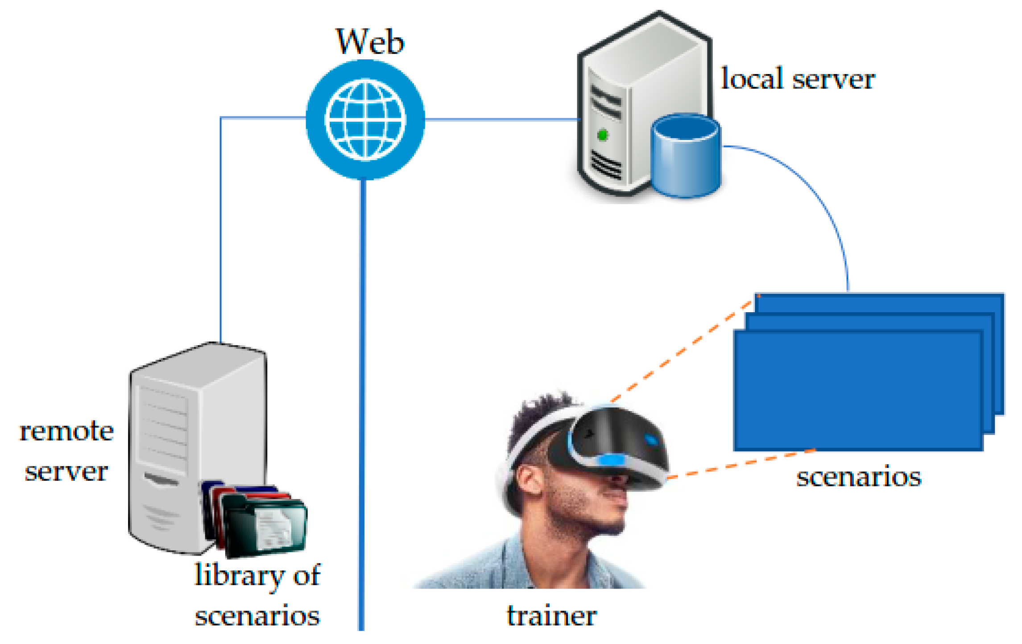
Design thinking

Slide 15
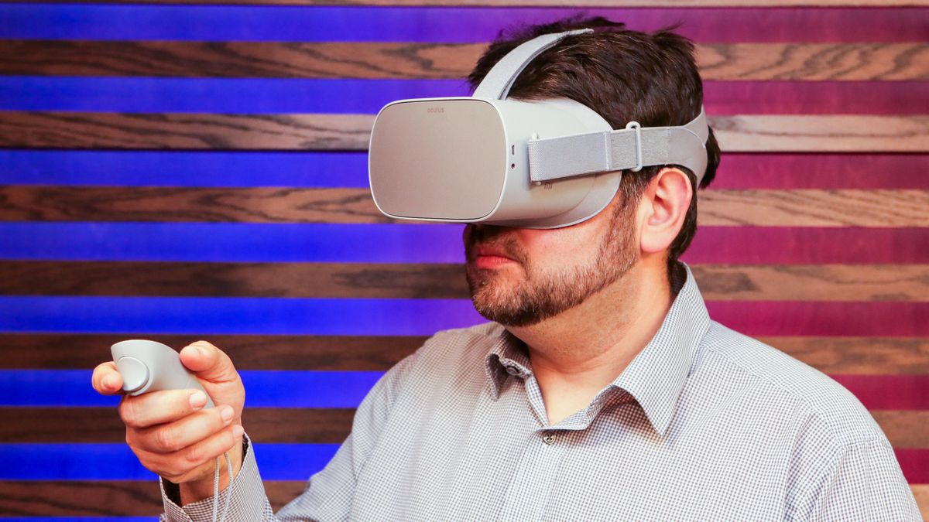
VR
Virtual Reality refers to a technology that utilizes visualizations of 3D objects and 360 environments. While the user does not interact with their real-world environment, they do interact with the virtual one visualized before them via special equipment. The required headset enables interactions based on sight, sound, and light movement. Additional accessories like controllers, gloves, shoes, cameras, etc. Provide finer, more nuanced control and interactions

Slide 16
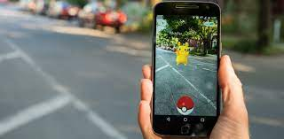
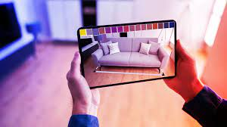
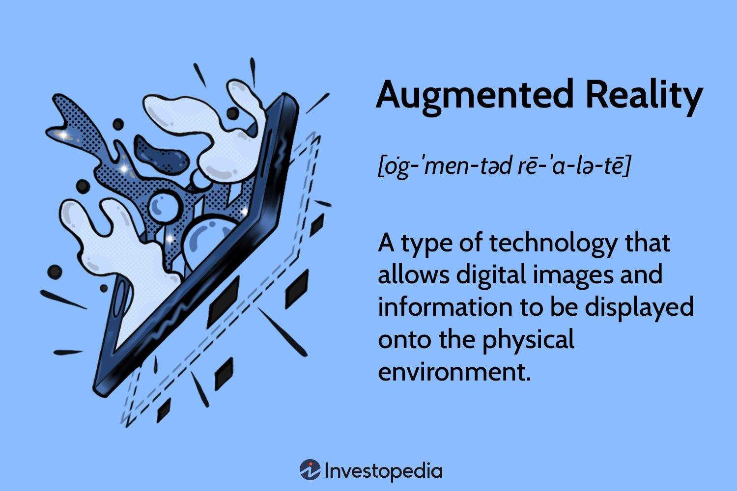
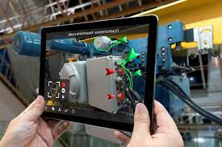
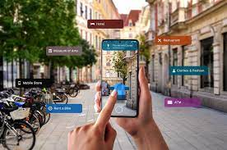
AR

Slide 17
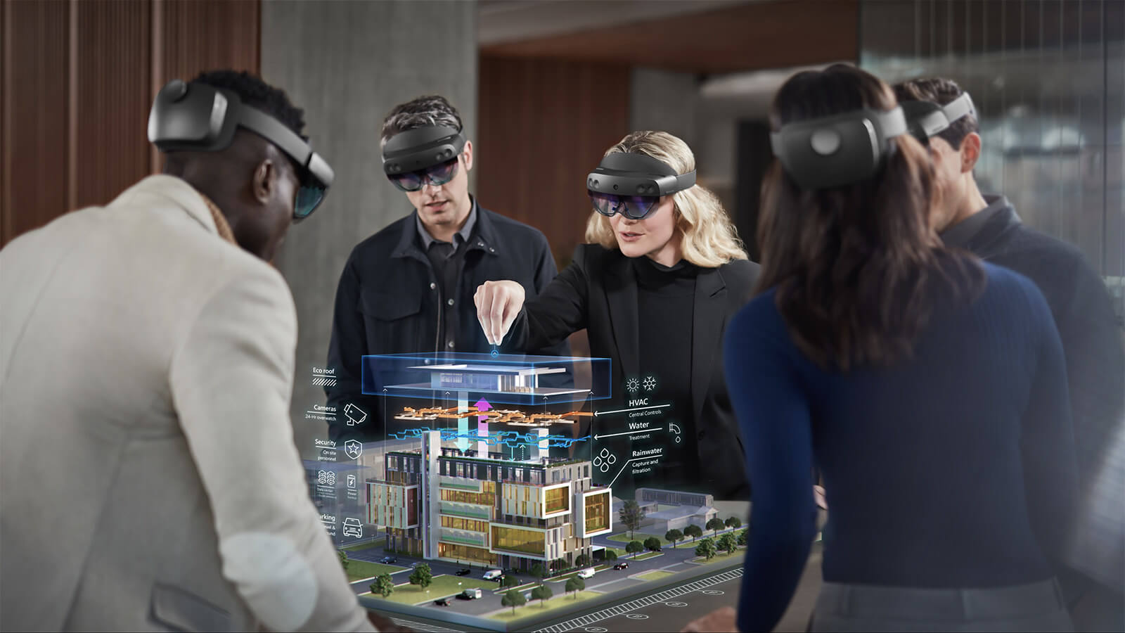
VR
Mixed Reality refers to a technology that utilizes data from the users environment and computer-generated elements to blend the real and virtual worlds together. Mixed Reality put more simply, is like AR but understands and reacts to the real-world environment. For example, while an AR application will be able to place a ball on a table, a ball in an MR application will roll off an uneven table and bounce on the floor.
Popular types of Mixed Reality applications include Training & Assistance like Microsoft Guides, and Microsoft Remote Assist.

Slide 18
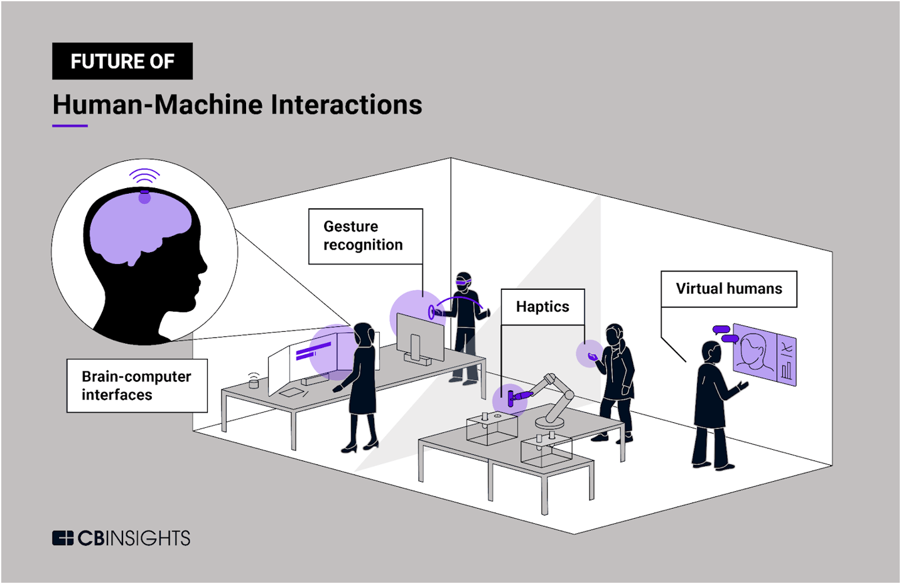
Future of HCI

Slide 19
Thank You!!

